Slide 2
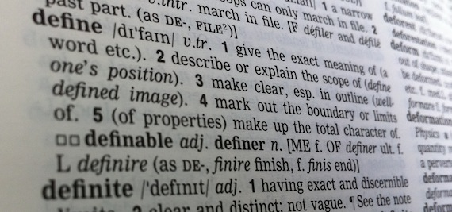



Host Security – Antivirus and Anti-malware
Signatures/definitions
Behavior monitoring
Heuristics and AI
Cloud-based submissions
Sandboxing vs. quarantining
Notes:
Client presents the list of supported cipher suite

Slide 3
Endpoint Detection and Response (EDR) Solutions
Endpoint threat detection
Monitor's endpoint behavior
Real time
Uses Indicators of Compromise
Examples
Fireeye EDR
Datashield EDR
Notes:
https://www.fireeye.com/products/endpoint-security/endpoint-detection-response.html
Visibility
Threat Database
Behavioral Pro

Slide 4
Data Loss Prevention/Protection
Protection of data in motion
Monitor and control data movement
Data classification
Examples
Personally Identifiable Information (PII)
Research and Development
Trade secrets
Notes:
Digital Guardian
https://digitalguardian.com/products/endpoint-dlp
McAfee Total Protection
https://www.mcafee.com/enterprise/en-us/assets/solution-briefs/sb-total-protection-for-dlp.pdf
Names SSN, DOB, Address, Telephone numbers, email addresses

Slide 5
Host-base Intrusion Detection and Prevention
Host-based intrusion detection
Passive software
Monitors, detection and alerts
Host-base intrusion prevention
Active software
Monitors, detections, alerts
Countermeasures
Notes:
https://www.solarwinds.com/security-event-manager?CMP=ORG-BLG-DNS-X_WW_X_NP_X_X_EN_X_X-SEM-20191023_8BestHIDSTools-_X_X_VidNo_X-X
https://www.ossec.net/
Anomaly-based detection
Signature attack detection
Zero-day attacks
Traffic monitoring at host
File integrity monitoring
Log analysis
Compliance and auditing
Notification and alerting system

Slide 6


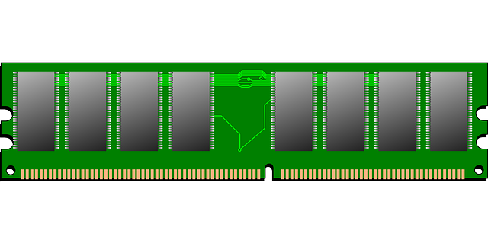
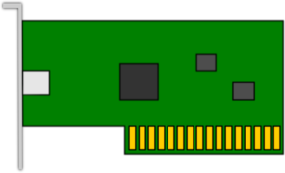
Host-based Firewalls
Monitor traffic on the host
Implicit deny
Monitoring
Disk
Memory
Network

Slide 7
Next Generation Firewalls
Marketing term
HIDS/HIPS
DLP
DNS filtering
URL filtering
Application Inspection
Application
SSL Inspection
Presentation
Session
State awareness (TCP)
Transport
Packet Inspection
Network
Data Link
Physical

